Slide 1


Alzheimer Disease Detection using Deep Learning
Indian Institute of Information Technology Pune
Guided By:
Dr. Rahul Dixit
Assistant Professor
Department of CSE
IIIT Pune
Presented By:
Suyash Ghadge
Mis No.: 222215007
1

Slide 2

Content
Introduction
Motivation for the Project
Literature Survey
Research Gaps
Problem Statement
Proposed System
Results or Prediction
Conclusion
Project Course Completion Status
Future Work
References
2

Slide 3
Introduction
Alzheimer disease is a chronic, irreversible disease that affects the cells of the brain and causes impairment of intellectual functioning.
Alzheimer disease is a brain disorder which gradually destroys the ability to reason, remember, imagine, and learn.
Using Vision Transformer we can easily detect Alzheimer is present or not.
Using these Deep Learning techniques, we can easily generate a model that provides high accuracy and precision which can be used in Medical Industry.
Using a particular dataset named Alzheimer MRI we can easily train our model and provide the required results for testing purpose.
3

Slide 4
Motivation for the Project
Due to extensive need of accurate results in the field of Medical Science and Research the Deep learning models are in a huge demand.
As the Image processed needs to be analyzed in a very proper sequence so as to achieve better results in order to save someone’s life, so the Deep learning models should be implemented using several discrete layers that could help us to gain high accuracy in minimum time complexity.
This will certainly form the step stones to achieve a huge target for creating huge transitions in the field of Medical Science, Research and Technology with respect to the memory and time constraints.
4

Slide 5
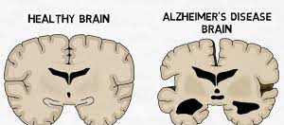
Comparison of a normal aged brain (left) and an Alzheimer patient’s brain (right).
5

Slide 6
Literature Survey
Sr.No. | Title | Year | Author | Publisher | Accuracy
1 | Alzheimer’s Diseases Detection by Using Deep Learning Algorithms | 2020 | SUHAD AL-SHOUKRY, TAHA H. RASSEM , NASRIN M. MAKBOL | IEEE | 93%
2 | Alzheimer’s disease detection using convolutional neural networks and transfer learning-based methods | 2020 | Marwa Zaabi, Nadia Smaoui, Houda Derbel, Walid Hariri | IEEE | 92.8%
6

Slide 7
Literature Survey
Sr.No. | Title | Year | Author | Publisher | Accuracy
3 | An Early Prediction and Detection of Alzheimer's Disease: A Comparative Analysis on Various Assistive Technologies | 2020 | Subetha T, Rashmita Khilar, Sarat Kumar Sahoo | IEEE | 92%
4 | Deep learning to predict Alzheimer's disease from neuroimaging of MRI analysis : A systematic study | 2020 | Ms. Kirthiga Devi T, Dr. Maragatham G , Ms. Janani S | ICPECTS | 90%
7

Slide 8
Literature Survey
Sr.No. | Title | Year | Author | Publisher | Accuracy
5 | Alzheimer’s Disease Detection Using Deep Learning-CNN | 2022 | Aditya Singh, Nishad Kharkar, Patel Priyanka & Suhasani Parvartikar | Springer | 91%
6 | Automated detection of Alzheimer's Disease using Deep Learning in MRI | 2021 | P C Muhammed Raees and Vinu Thomas | IOPSCIENCE | 88%
8

Slide 9
Research Gaps
Several researches are made with the use of not much usage of Deep Learning algorithms with a considerable accuracy.
These research work have not made the use of Image Processing Algorithms or techniques or increasing the number of extractions layers for optimizing search in order to obtain a robust accuracy for new data points in order to free our images from noise or any other default disturbances.
Also, the efficiency of the model also gets decreased while performing the train data epoch estimation and test data evaluation.
9

Slide 10
Problem Statement
To detect whether the person is suffering from Alzheimer by uploading the certain required MRI image.
To develop a highly accurate Deep Learning model using several Deep Learning Algorithms such as Convolutional Neural Network, Vision Transformer, AlexNet, DenseNet, InceptionV3 in order to achieve best results.
10

Slide 11
Proposed System
Provide a detailed description and classification results by developing a Deep Learning Model generated from the 5 Deep Algorithms Convolutional Neural Network, Vision Transformer, AlexNet, DenseNet, InceptionV3 i.e. that provides accurate results.
To set up and work on different algorithms in order to obtain a most robust algorithm for new test cases and for the required scenario.
11

Slide 12
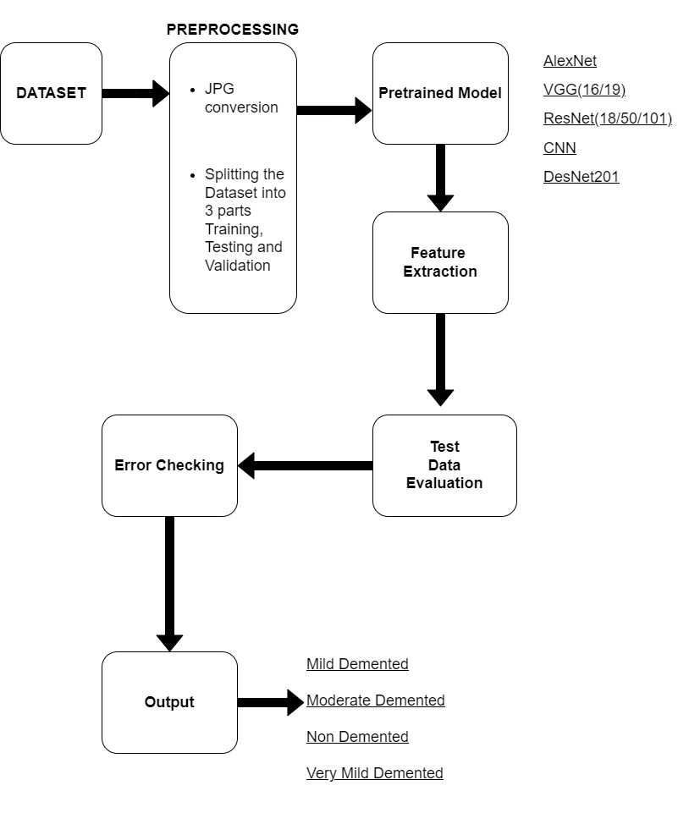
12

Slide 13
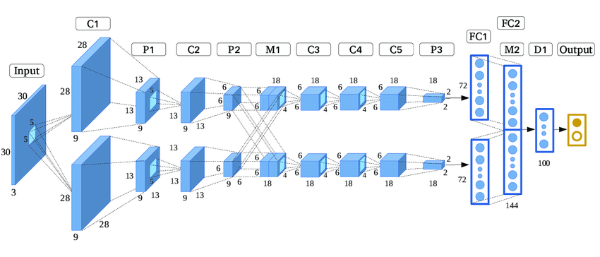
Algorithms Used: Transfer Learning such as InceptionV3, DenseNet, AlexNet
13

Slide 14
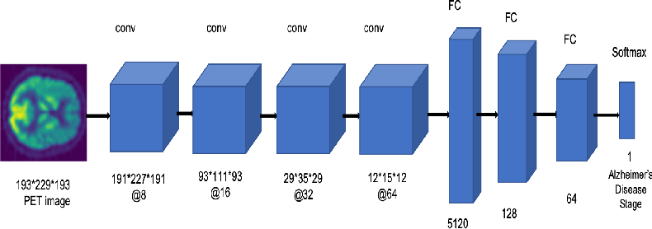
Convolutional Neural Network (CNN)
14

Slide 15
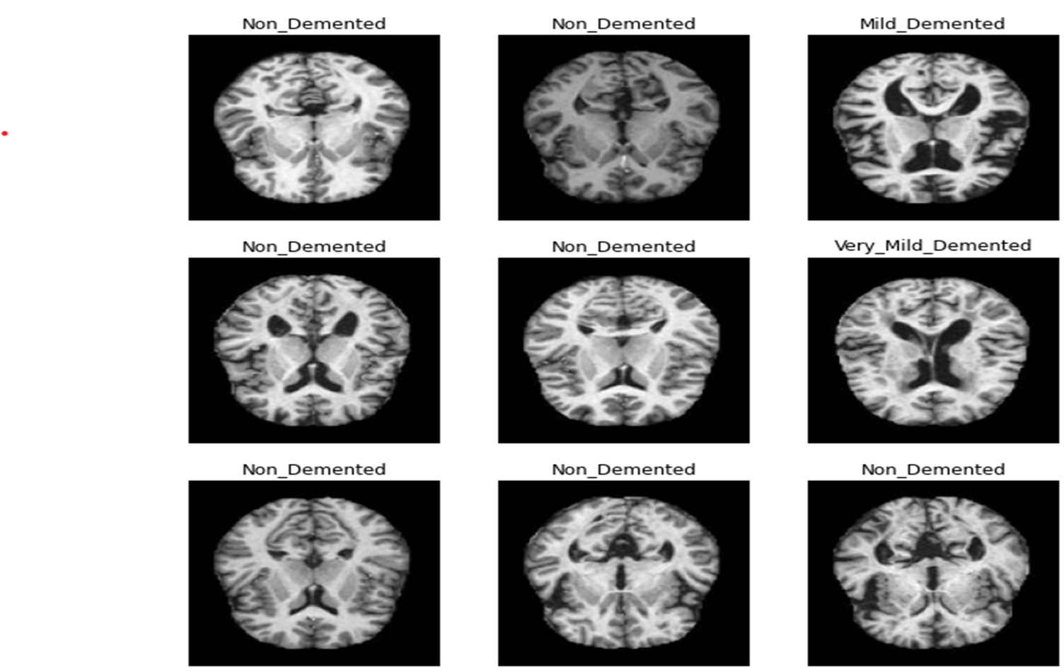
Results or Prediction
The Dataset is consisting of total 6400 MRI images. Class - 1: Mild Demented (896 images) Class - 2: Moderate Demented (64 images) Class - 3: Non-Demented (3200 images) Class - 4: Very Mild Demented (2240 images)
15

Slide 16
As per the accuracies generated from several algorithms, we have received the required data. They are as follows:
Algorithms | Accuracy
CNN | 78.87%
Vision Transformer | 99.33%
AlexNet | 49.50%
DenseNet | 96.74%
InceptionV3 | 80.63%
16

Slide 17
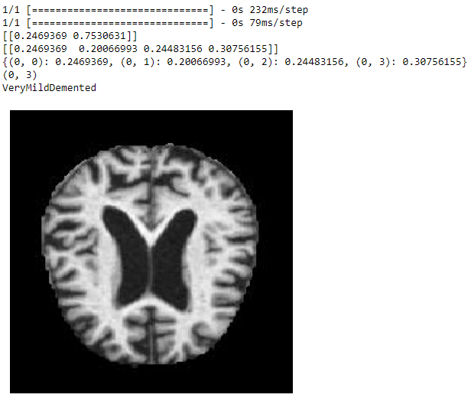
CNN Evaluation
The given image falls in the ModerateDemented class but our CNN model has accurately classified it as VeryMildDemented category.
As the given model gives the considerable accuracy of 78.87%
Hence, there are high chances of classifying bunch of images in a much commendable manner.
17

Slide 18
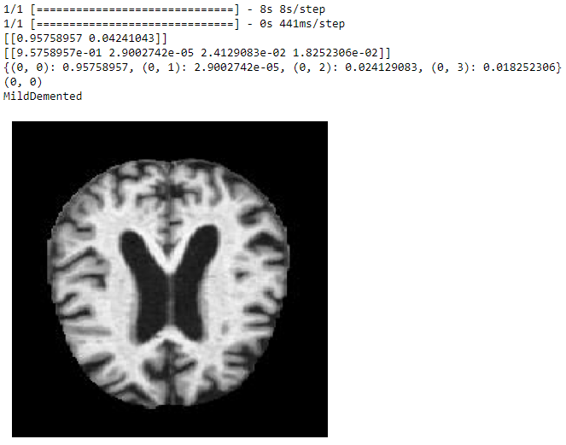
DenseNet Evaluation
The given image falls in the MildDemented class and our DenseNet model has accurately classified it as MildDemented category.
As the given model gives the considerable accuracy of 96.74%
Hence, there are high chances of classifying bunch of images in a much commendable manner.
18

Slide 19
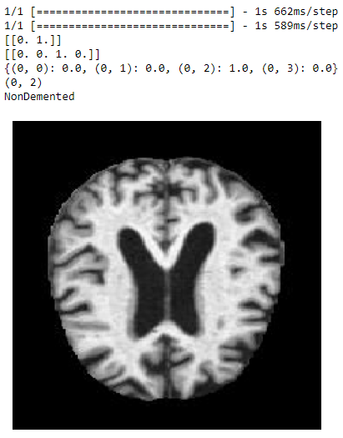
AlexNet Evaluation
The given image falls in the MildDemented class but our AlexNet model has not accurately classified it as MildDemented category.
As the given model gives the accuracy of 49.50%
Hence, there are high chances that this model will always give some errors and is not much robust enough for new test cases.
19

Slide 20
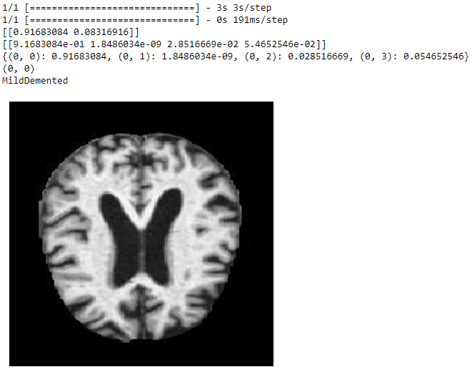
MyInception Evaluation
The given image falls in the MildDemented class and our DenseNet model has accurately classified it as MildDemented category.
As the given model gives the considerable accuracy of 80.63%
Hence, there are high chances of classifying bunch of images in a much commendable manner.
20

Slide 21
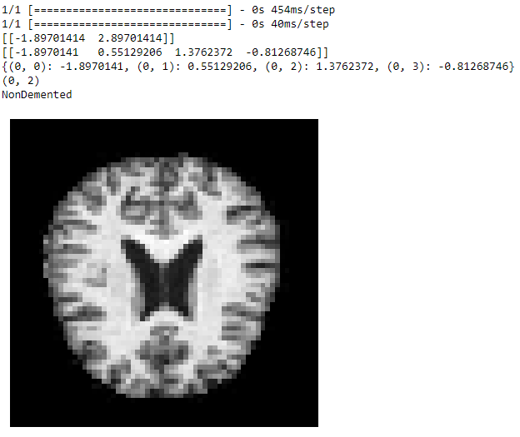
Vision Transformer Evaluation
The given image falls in the NonDemented class and our Vision Transformer model has accurately classified it as NonDemented category.
As the given model gives the considerable accuracy of 99.33%
Hence, there are high chances of classifying bunch of images in a much commendable manner.
21

Slide 22
Conclusion
Model obtained from ViT have gained a much considerable accuracy for the given data points.
This platform would act as a carrier or a bridge between the patients and the medical assistance.
ViT Model can be suitable enough for several huge and new data points.
By using, learning and experiencing several Image Processing algorithms we can develop a sharpened, enhanced image so as to pass through the ViT model in a much robust manner.
Image Processing algorithms help us to get a robust image which increases efficiency of the model as well to detect the disease.
In the field of medical science, it is certainly another approach to deal with several diseases.
22

Slide 23
Project Course Completion Status
Task | Start Month | End Month
Collecting the Dataset | January 2023 | January 2023
Literature Survey | February, 2023 | February, 2023
Project Objectives and Importance Determination | February, 2023 | February, 2023
Model Building & Training | February, 2023 | March, 2023
Testing & Saving the model | March, 2023 | April, 2023
23

Slide 24
Future Work
Medical Associates and technologies can play an important role in finding out the case studies of the patient.
The image patches or MRI images can certainly help them to get acquainted with the new test cases with high accuracy as compared to the different Deep Learning models or any other approach.
More image and pixel resolution can certainly improvise the accuracy rate.
Any new approach in the field of Deep Learning can certainly resolve the issues of several image classification problems related to required curable diseases.
24

Slide 25
References
A. Chaddad, C. Desrosiers, and T. Niazi, ‘‘Deep radiomic analysis of MRI related to Alzheimer’s disease,’’ IEEE Access, vol. 6, pp. 58213–58221, 2018
I. P. Vatanabe, P. R. Manzine, and M. R. Cominetti, ‘‘Historic concepts of dementia and Alzheimer’s disease: From ancient times to the present,’’ Revue Neurologique, vol. 176, no. 3, pp. 140–147, Mar. 2020.
J. McCleery, L. Flicker, E. Richard, and T. J. Quinn, ‘‘The national institute on aging and Alzheimer’s association research framework: A commentary from the cochrane dementia and cognitive improvement group,’’ Alzheimer’s Dementia, vol. 15, no. 1, pp. 179–181, Jan. 2019.
M. BALAMURUGAN, A. NANCY and S. VIJAYKUMAR, Biomedical Pharmacology Journal, ”Alzheimer’s Disease Diagnosis by Using Dimensionality Reduction Based on KNN Classifier”, vol. 10, pp. 1823- 1830, 2017.
25

Slide 26
References
Karrer, M., Schnelli, A., Zeller, A., & Mayer, H. (2020). A systematic review of interventions to improve acute hospital care for people with dementia.
Chong, A. K., Molaie, A. M., & Fisher, J. E. (2020). A contextual model of care for persons with dementia. In Functional Analysis in Clinical Treatment (pp. 245-269). Academic Press.
M. Menikdiwela, C. Nguyen and M. Shaw, ”Deep learning on brain cortical thickness data for disease classification”, vol. 18, 2018.
D. Manzak, G. Cetinel and A. Manzak, ”Automated Classification of Alzheimer’s Disease using Deep Neural Network (DNN) by Random Forest Feature Elimination”, vol. 19, pp. 1050-1053, August 2019.
26

Slide 27

Thank You
27

